Slide 1
A Walk Along Germantown Avenue
“The story of Germantown Avenue can serve in many respects
as a metaphor for the whole city.”
Elijah Anderson, Code of the Street

Slide 2
Introduction
For more than forty years, we have lived in close proximity to Germantown Avenue, a street that stretches 8 ½ miles through diverse neighborhoods across Philadelphia. Surprisingly, in all these years, neither of us traveled the length of the Avenue. This road, just blocks from our homes, was both extraordinarily familiar yet starkly unfamiliar. It is also a street that offers entry into the daily lives of many different communities across our city. Out of these two realizations, our project was born.
We became interested in photographing the people along the Avenue, not architecture or landmarks. We wanted to know who lived, worked and hung out on the Avenue, and we explored it from one end to the other. We allowed ourselves to be led by what we saw and felt. We also opened ourselves up to the environment and became vulnerable and streetwise.
We traveled along Germantown Avenue, introducing ourselves to people over the course of several months, and sharing our project with them. Our cameras gave us entree into their space and allowed us to engage them. The response from almost everyone was very positive, and we were overwhelmed by their sincerity and interest in what we were doing. Talking with so many people allowed us to learn about their lives. In doing that, we also learned more about ourselves.
We have been privileged to hear peoples’ stories, capture their images, and reveal their humanity and individuality.
Carolyn Johnson Ellie Seif

Slide 3
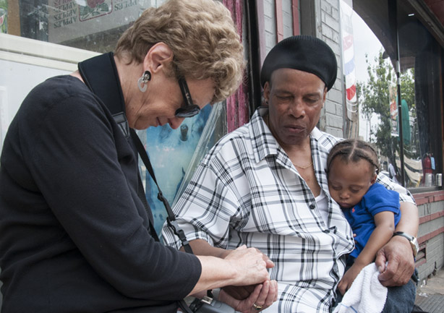
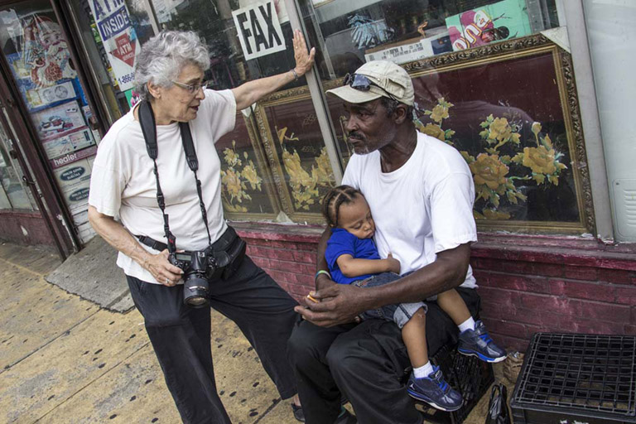
Carolyn, Fred and Christopher
Ellie, Greg and Christopher

Slide 4
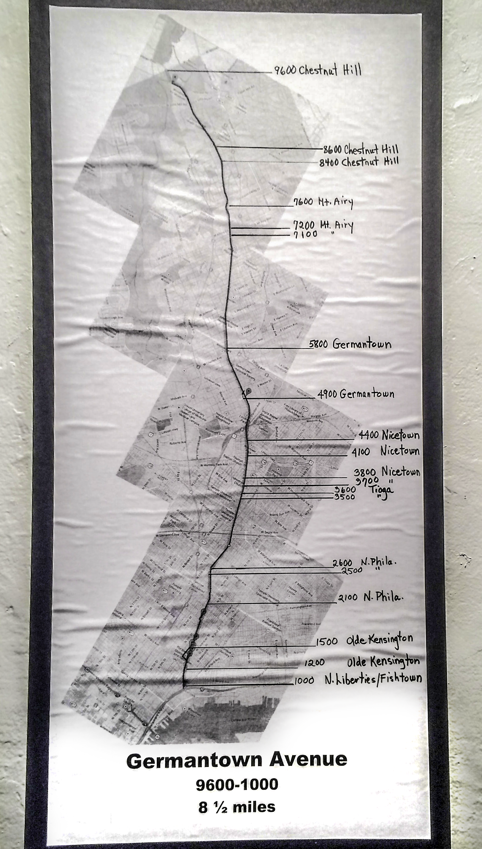

Slide 5
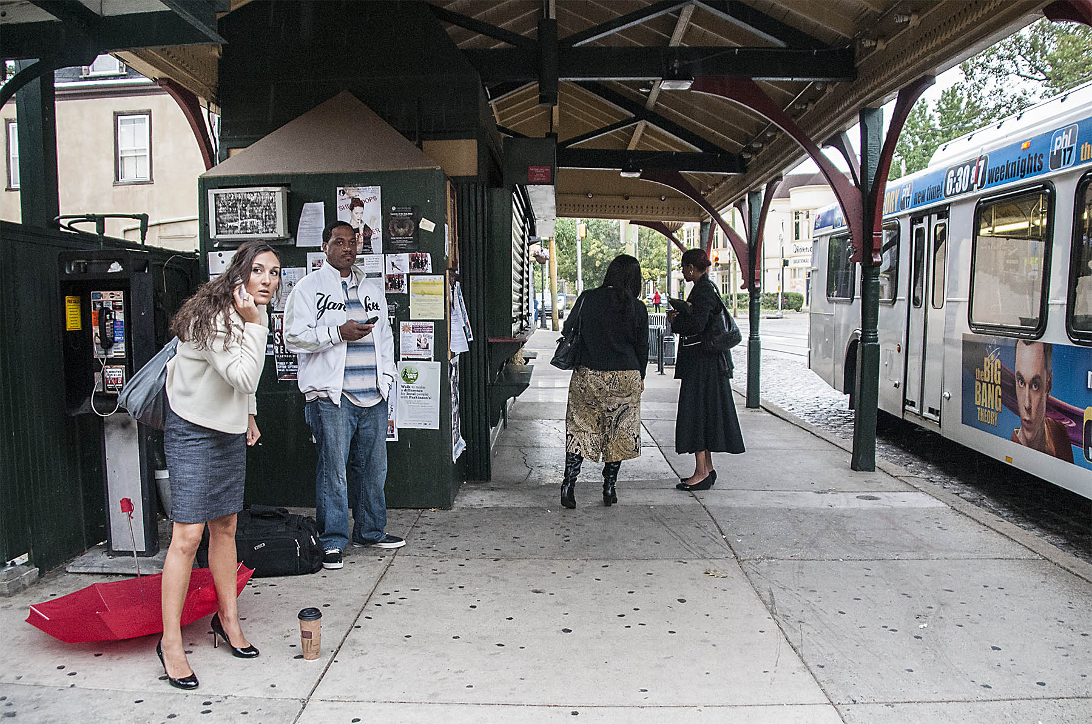
Photograph by Ellie Seif
8600 Block
Early morning at the Top of the Hill - Chestnut Hill Bus and Train Stations

Slide 6
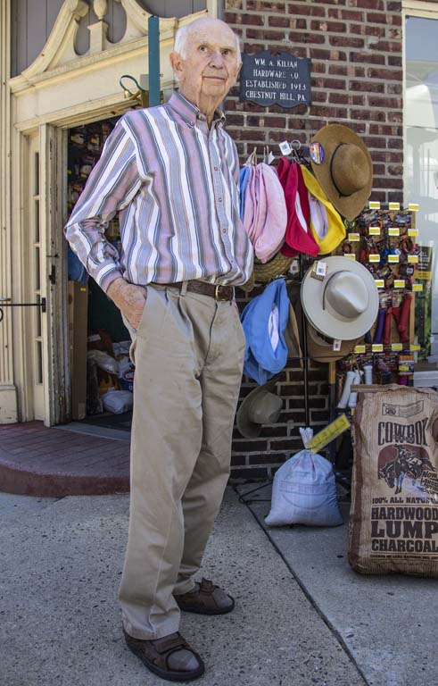
Photograph by Carolyn Johnson
8400 Block
Russell, owner of Kilians Hardware store, a 100-year-old family business.

Slide 7
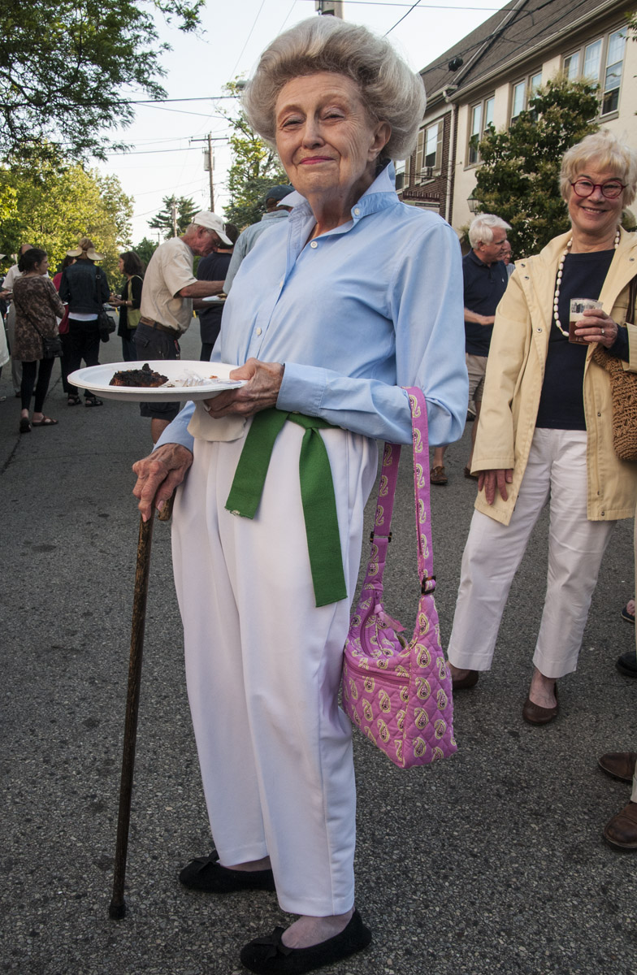
Photograph by Ellie Seif
8400 Block
Long time Germantown Cricket Club employee, Pat, at Kilians anniversary party.

Slide 8
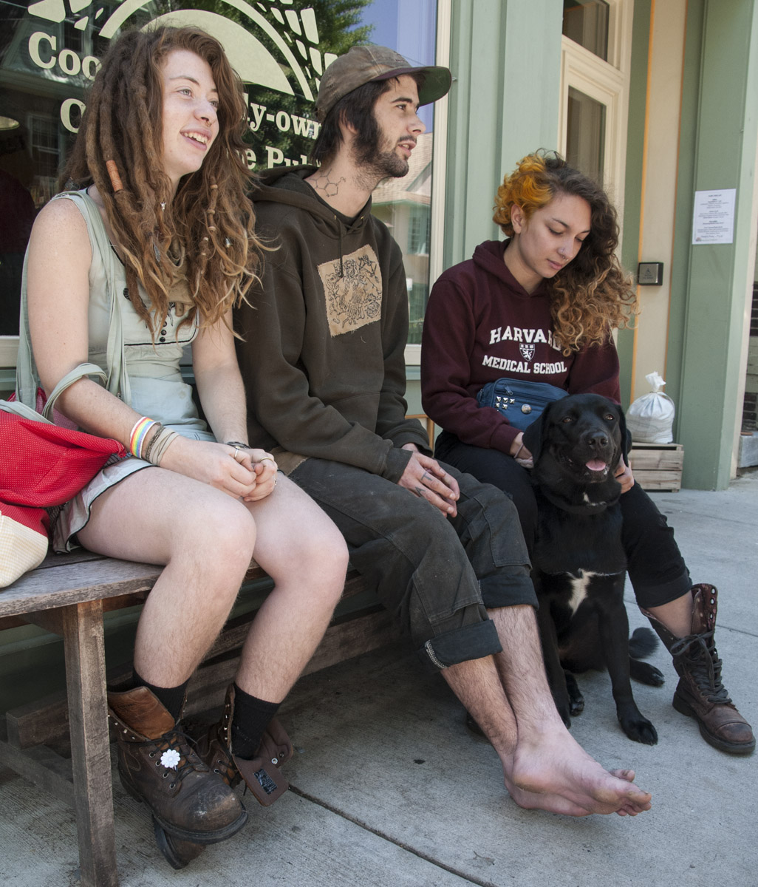
Photograph by Ellie Seif
8400 Block
These musicians travel around the country riding the rails. They spent time with a friend in Chestnut Hill.

Slide 9
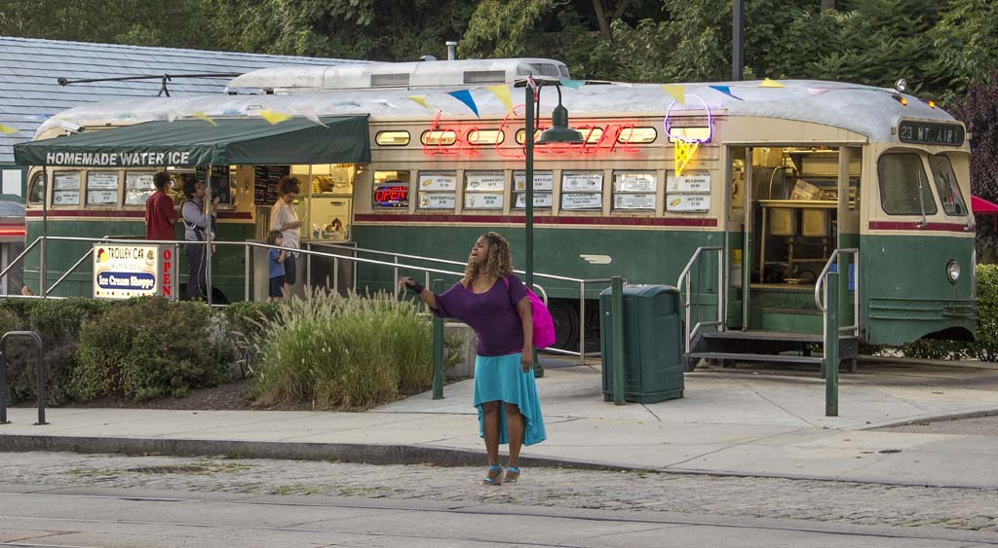
Photograph by Carolyn Johnson
7600 Block
A woman on her way to the New Covenant Campus for a meeting.

Slide 10
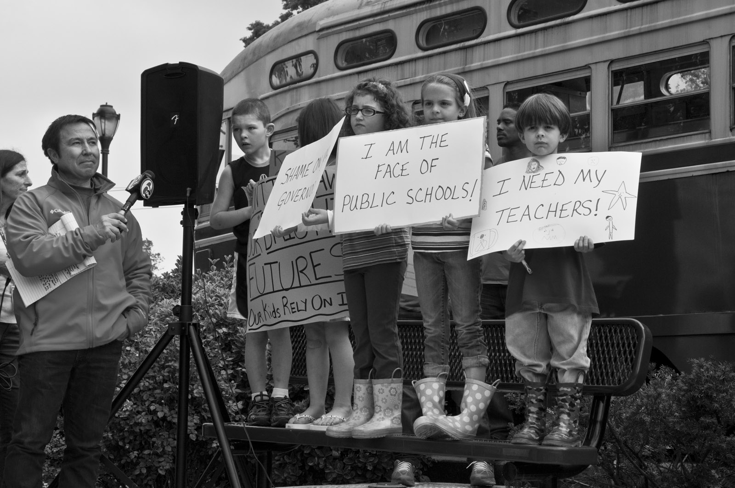
Photograph by Ellie Seif
7600 Block

Slide 11
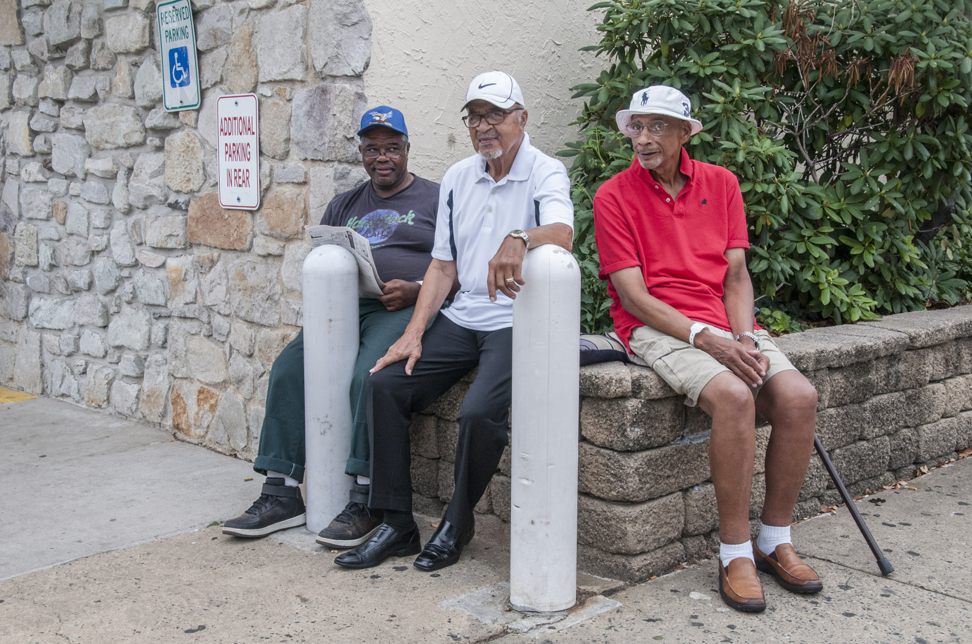
Photograph by Ellie Seif
7200 Block
Greg, Hat and Bill meet daily for their early morning get-together at the Wawa.

Slide 12
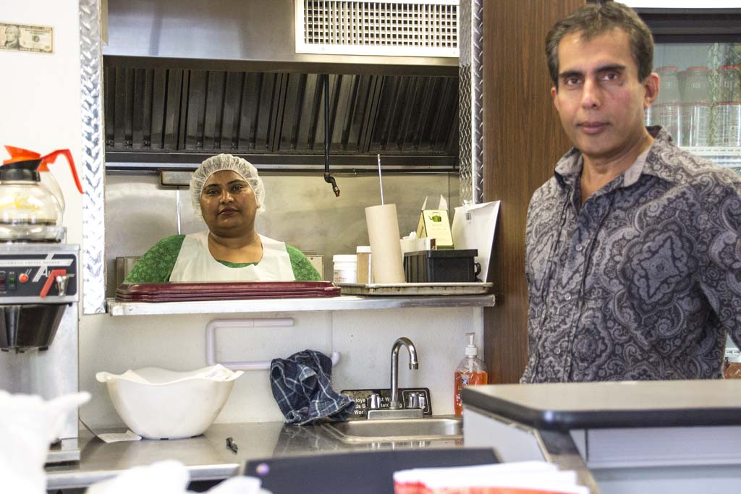
Photograph by Carolyn Johnson
7200 Block
Behind the scenes at family owned Jyoti Indian Bistro.

Slide 13
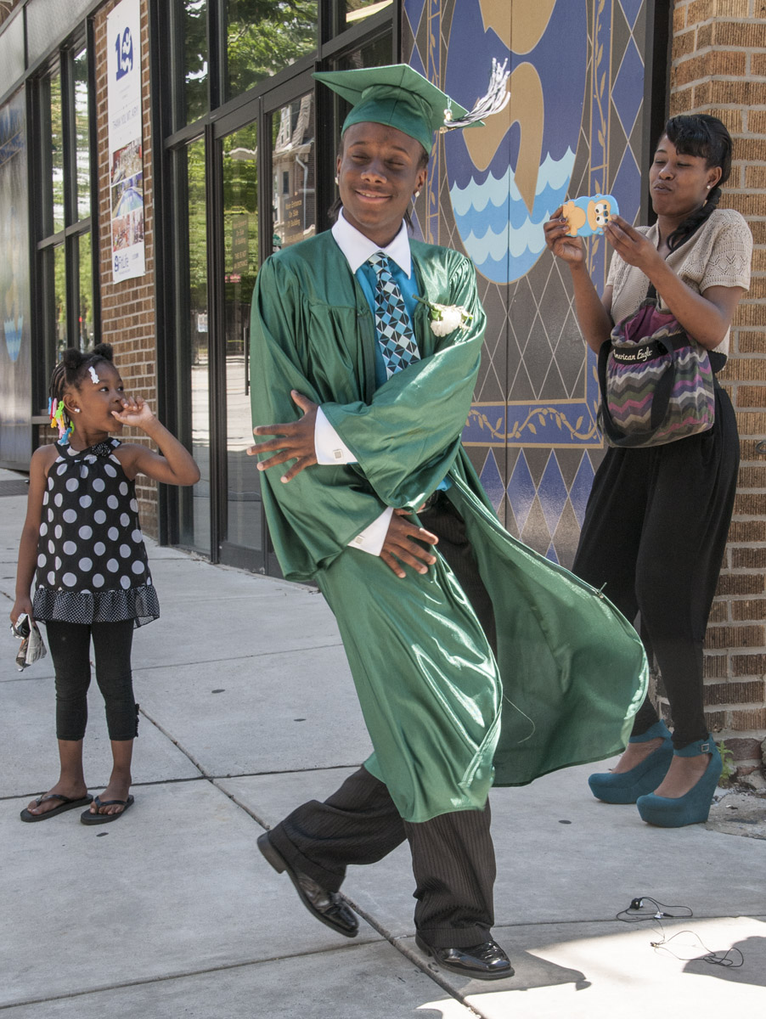
Photograph by Ellie Seif
7100 Block
A member of the final graduating class of Germantown High School celebrates with his
family and looks forward to studying dance.

Slide 14
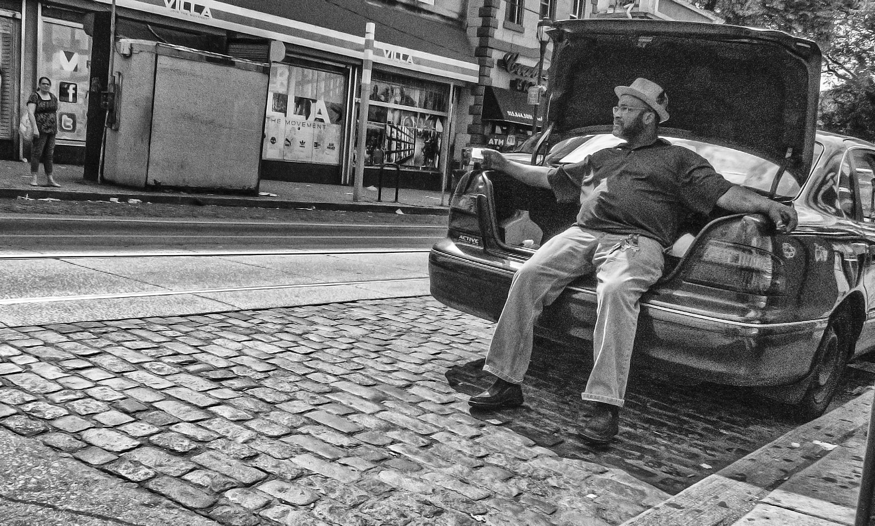
Photograph by Ellie Seif
5800 Block

Slide 15
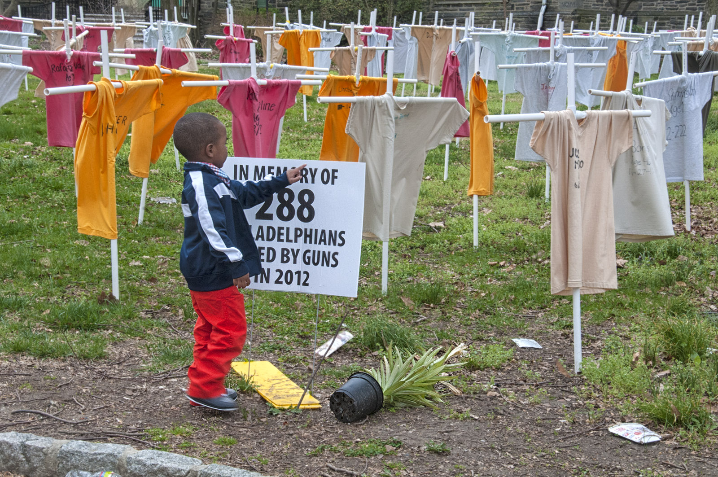
Photograph by Ellie Seif
5800 Block
4-year-old, practicing his letters

Slide 16
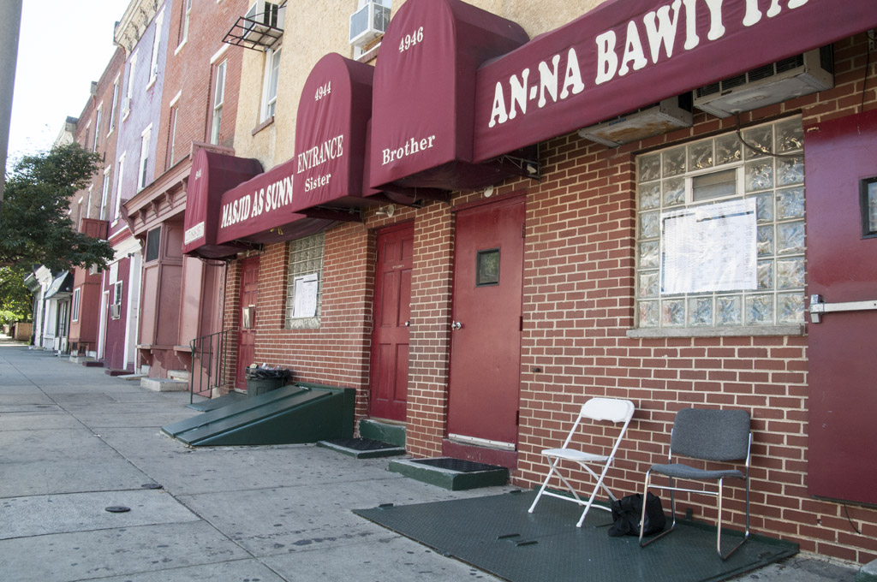
Photograph by Ellie Seif
4900 Block
These chairs had been occupied by two Muslim elders only moments before this photograph was taken. They explained that having their pictures taken was against their beliefs but they were happy to step inside so the masjid (mosque) could be photographed.

Slide 17
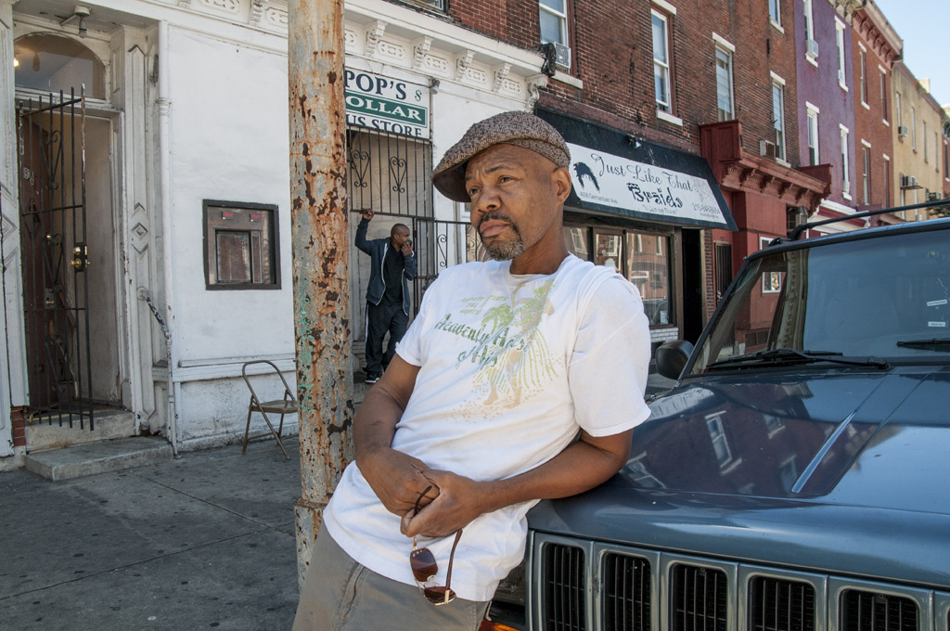
Photograph by Ellie Seif
4900 Block
Five doors down from the masjid (mosque) are two lifelong residents of the neighborhood. The man in the background is the owner of Pop’s Dollar Plus Store.

Slide 18
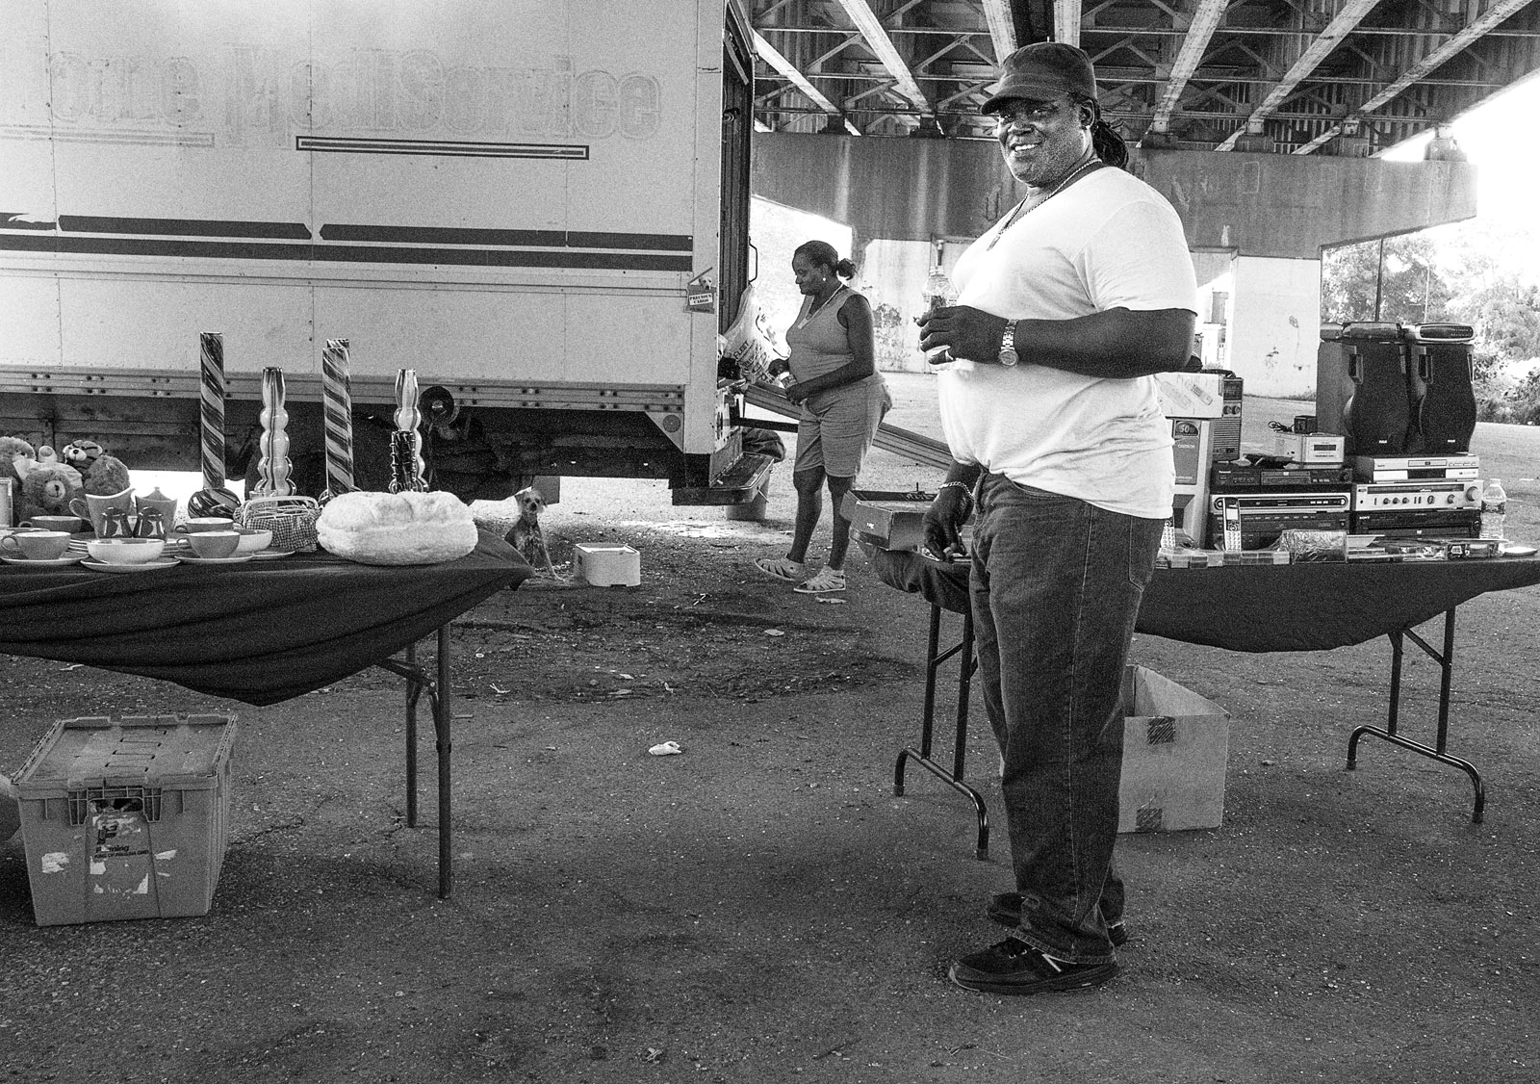
Photograph by Ellie Seif
4400 Block
James and his wife operate this flea market under Roosevelt Blvd. They also set out free goods for people in the neighborhood.

Slide 19
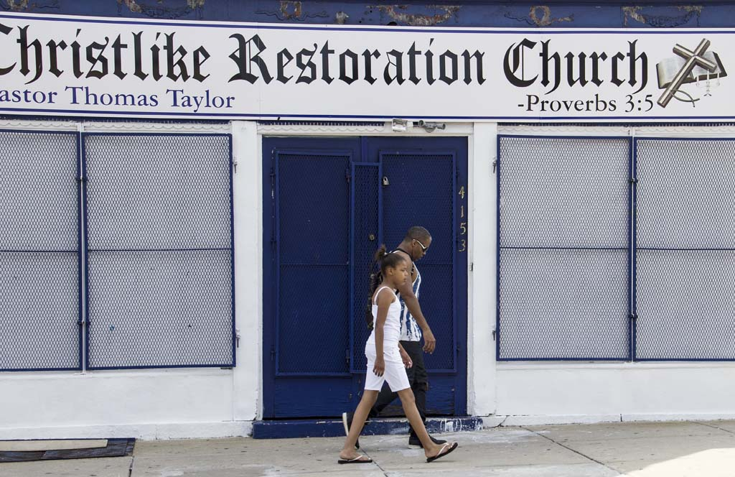
Photograph by Carolyn Johnson
4100 Block

Slide 20
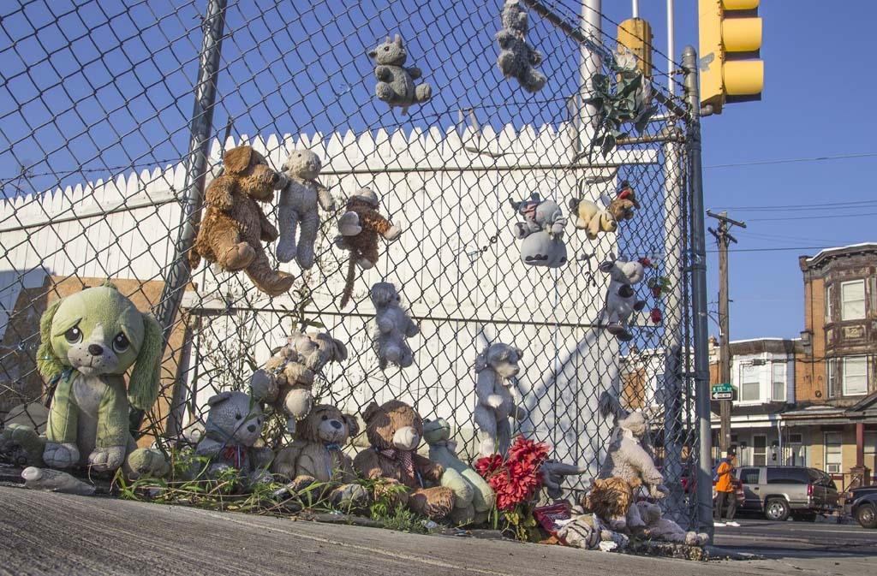
Photograph by Carolyn Johnson
3800 Block
Lee, 37, was killed last spring in a
shoot-out on this corner, one block from his home.

Slide 21
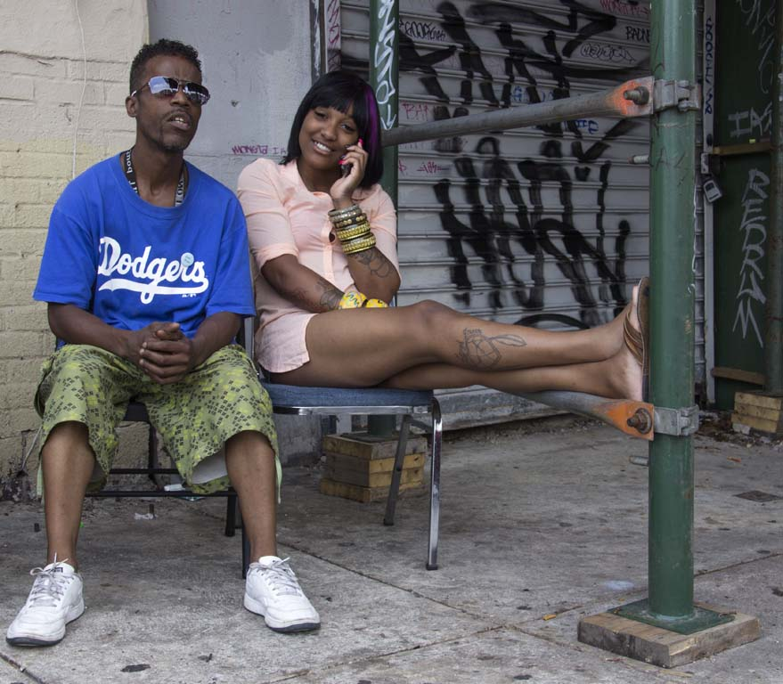
Photograph by Carolyn Johnson
3700 Block
Vaughn and his friend sitting near the hair salon where she works.

Slide 22
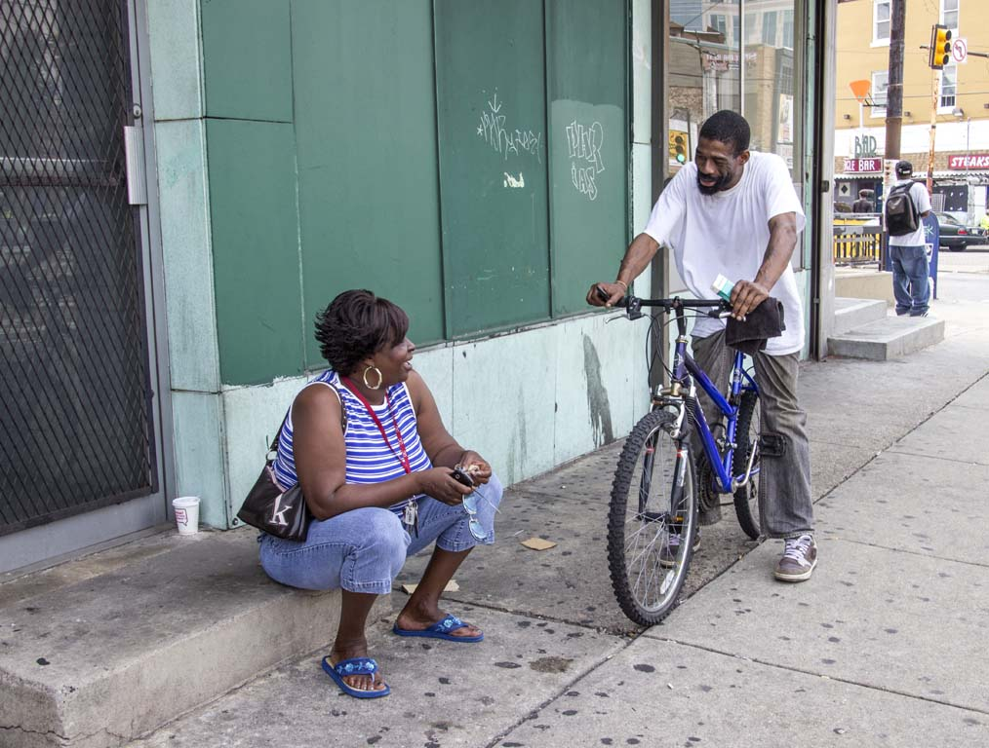
Photograph by Carolyn Johnson
3700 Block

Slide 23
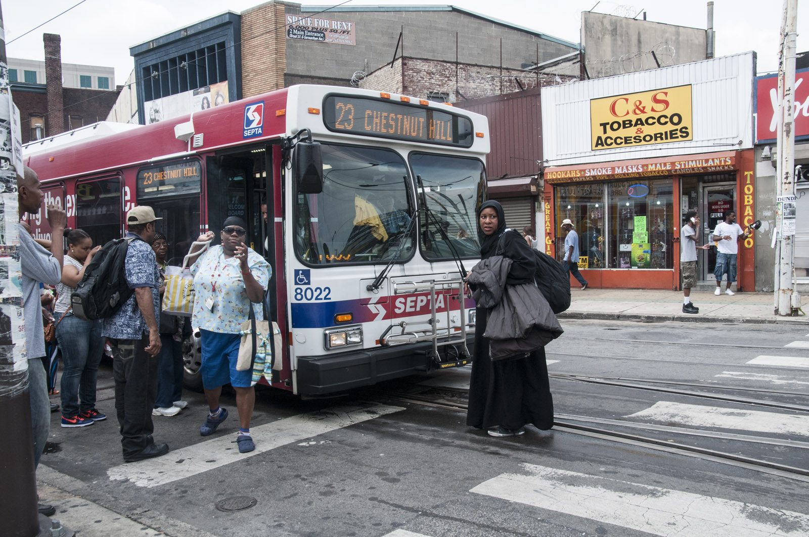
Photograph by Ellie Seif
3600 Block
Intersection of Broad, Germantown and Erie.

Slide 24
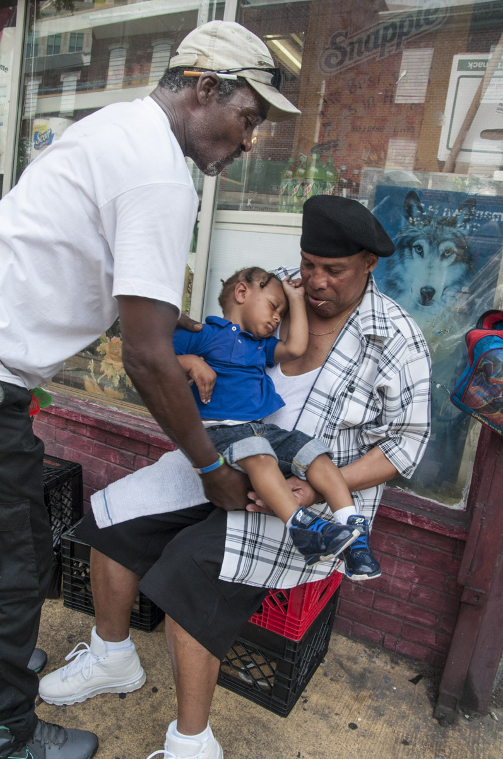
Photograph by Ellie Seif
3500 Block
Godfather Greg passes 2-year-old Christopher to Grandpa Fred. Fred spends time with Christopher on his day off, wanting him to have a better life than he had.

Slide 25
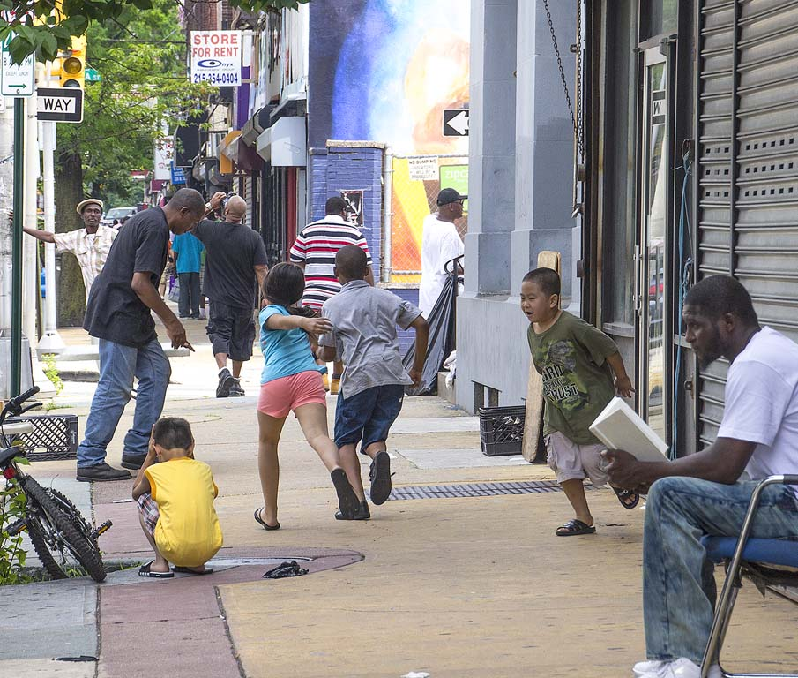
Photograph by Carolyn Johnson
3500 Block

Slide 26
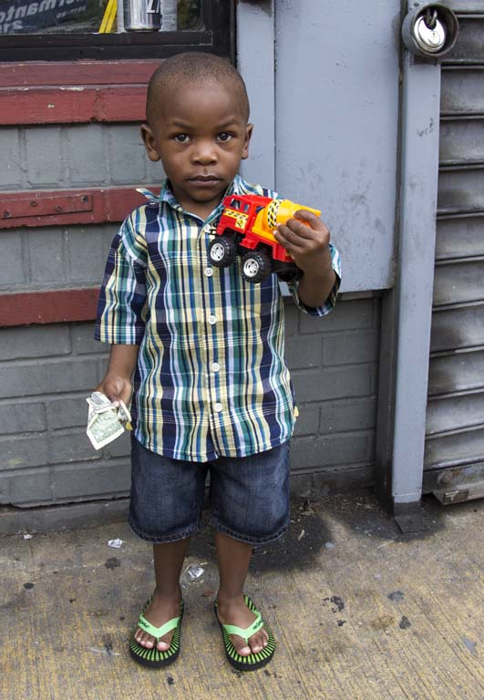
Photograph by Carolyn Johnson
3500 Block
Little boy poses with his new cement mixer.

Slide 27
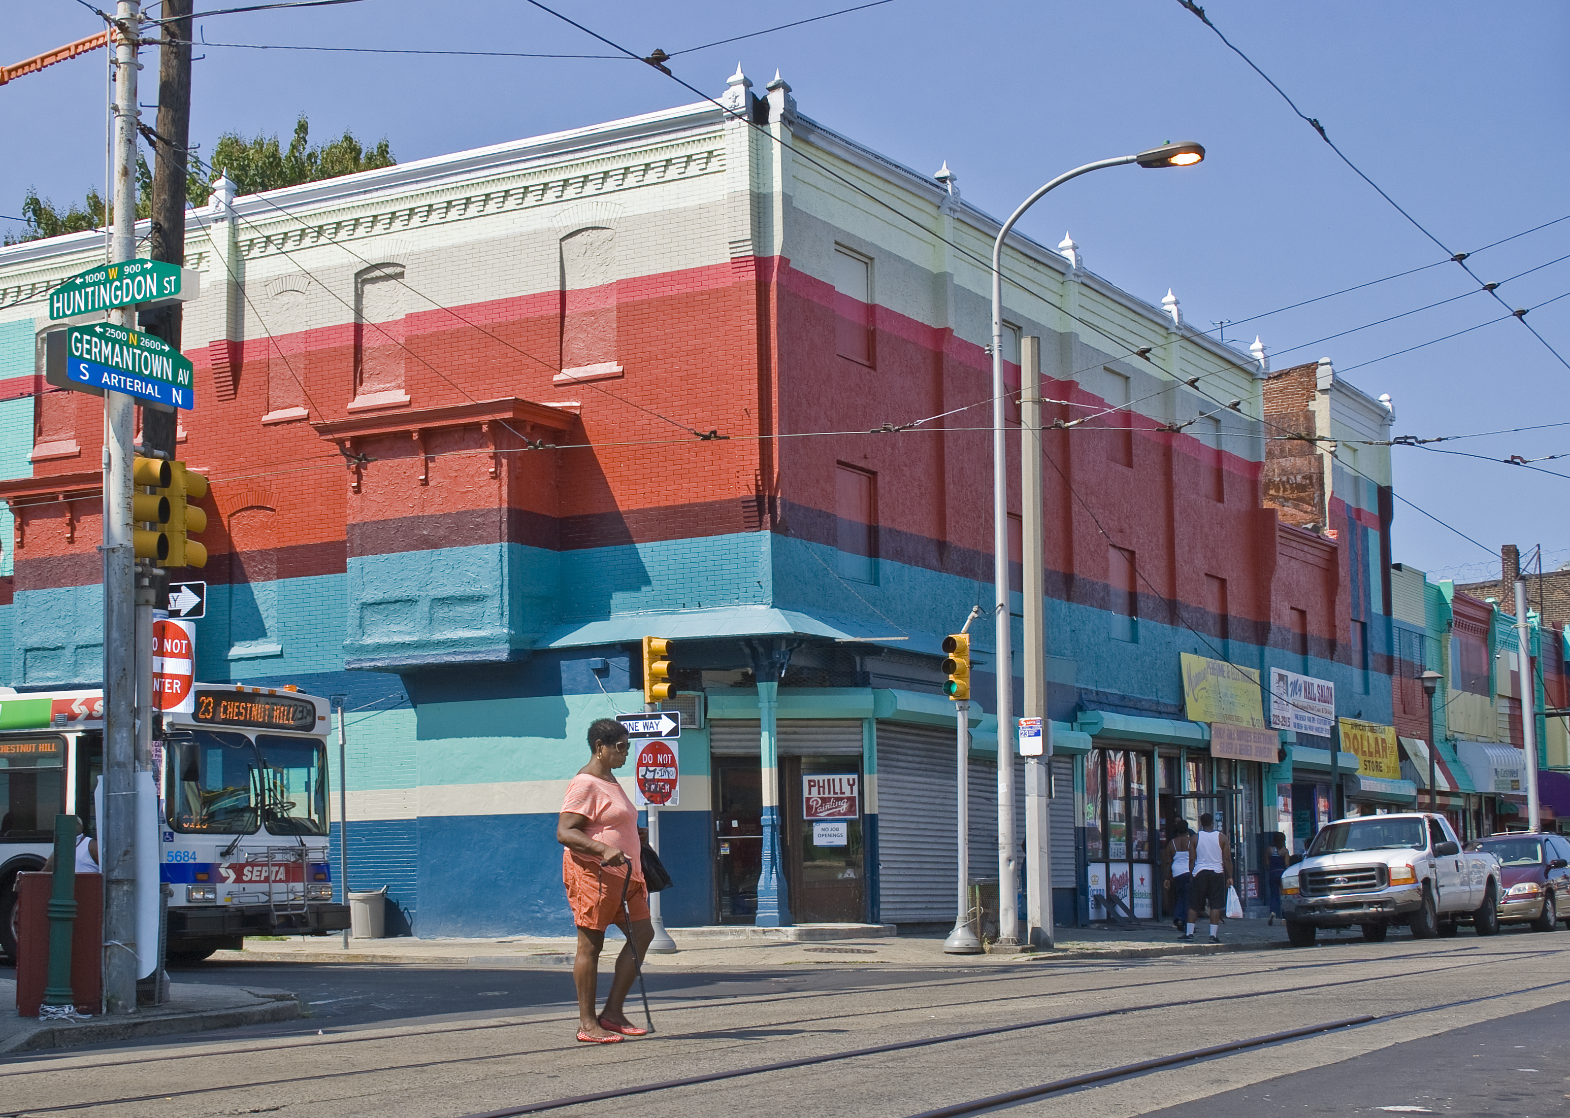
Photograph by Carolyn Johnson
2600 Block
Neighborhood woman in color coordinated outfit fits with this section of North Philadelphia, which was recently painted by the Mural Arts Program.

Slide 28
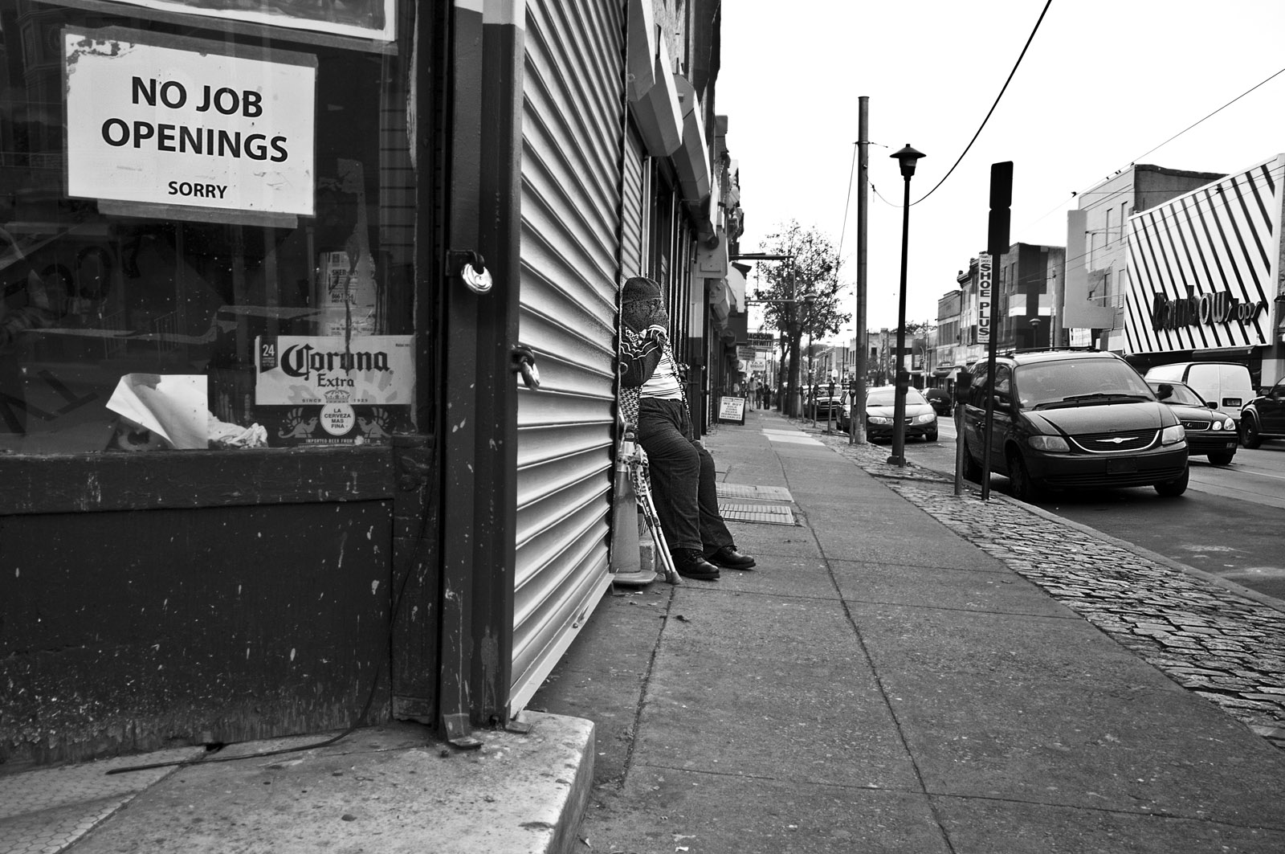
Photograph by Ellie Seif
2600 Block

Slide 29
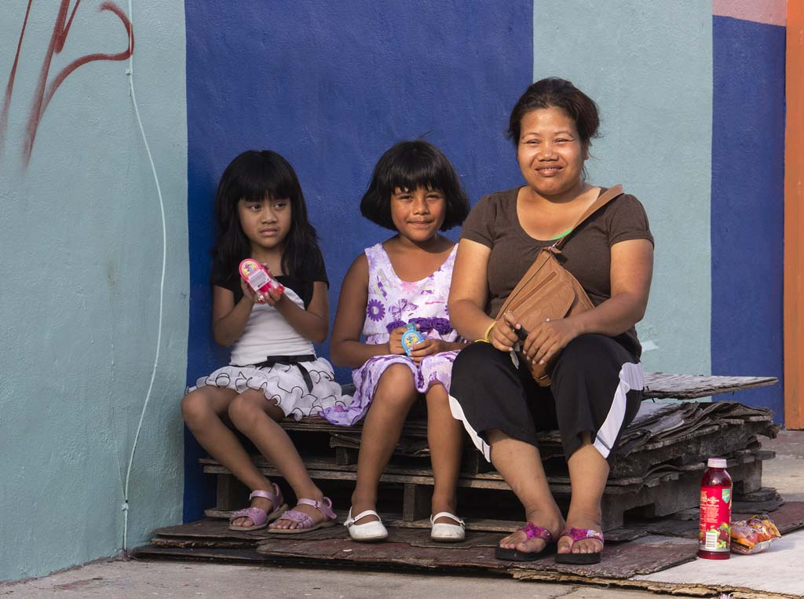
Photograph by Carolyn Johnson
2600 Block
Mother, originally from Thailand, buys her two daughters treats on a steamy summer evening.

Slide 30
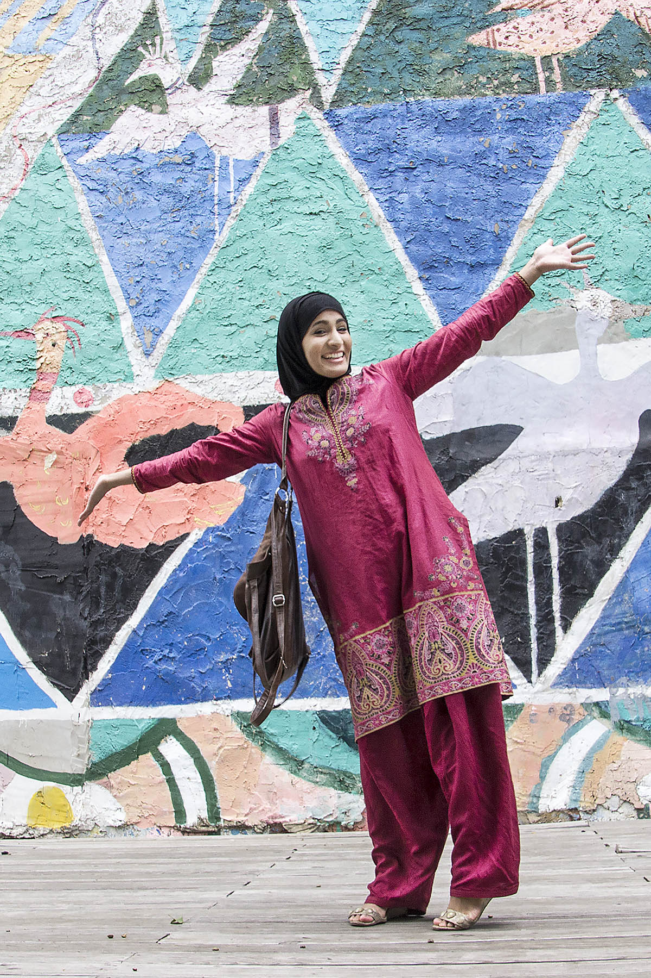
Photograph by Carolyn Johnson
2500 Block
Exuberant woman on her way to Friday prayer, walked through a Village of Arts and Humanities park, and asked to have her picture taken.

Slide 31
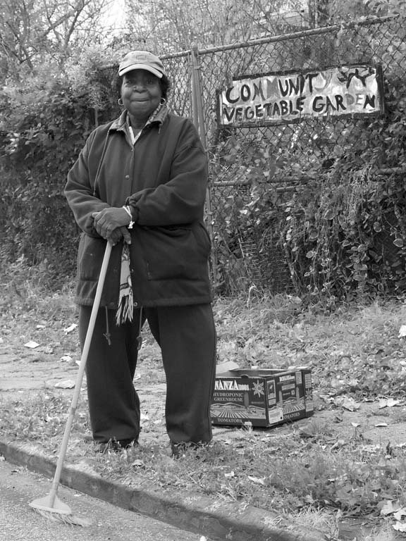
Photograph by Carolyn Johnson
2500 Block
Despite crippling arthritis, this woman works to keep the neighborhood beautiful.

Slide 32
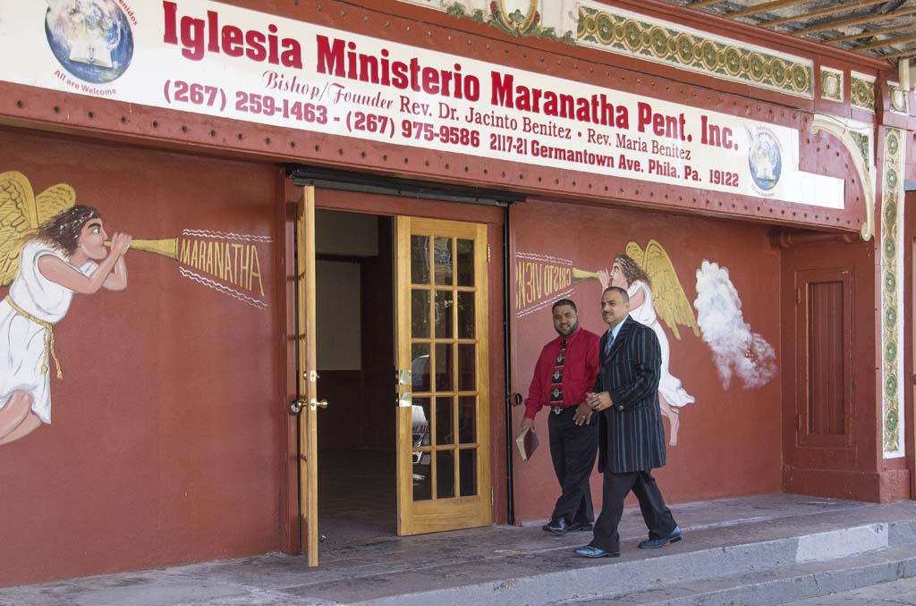
Photograph by Carolyn Johnson
2100 Block
Two men enter this Spanish speaking church on Sunday morning.

Slide 33
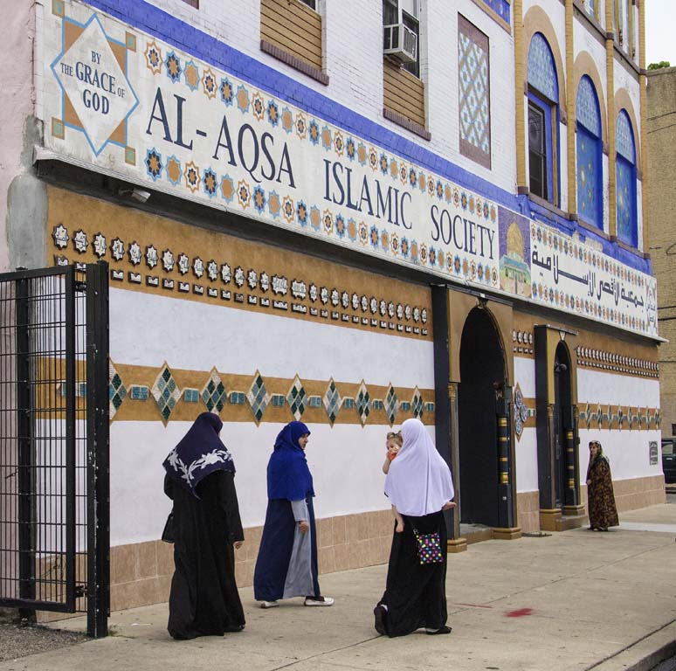
Photograph by Carolyn Johnson
1500 Block
Women gather for Friday prayer at the Al Aqsa Mosque, which draws members from Philadelphia and Muslims immigrating to Philadelphia from around the world.

Slide 34
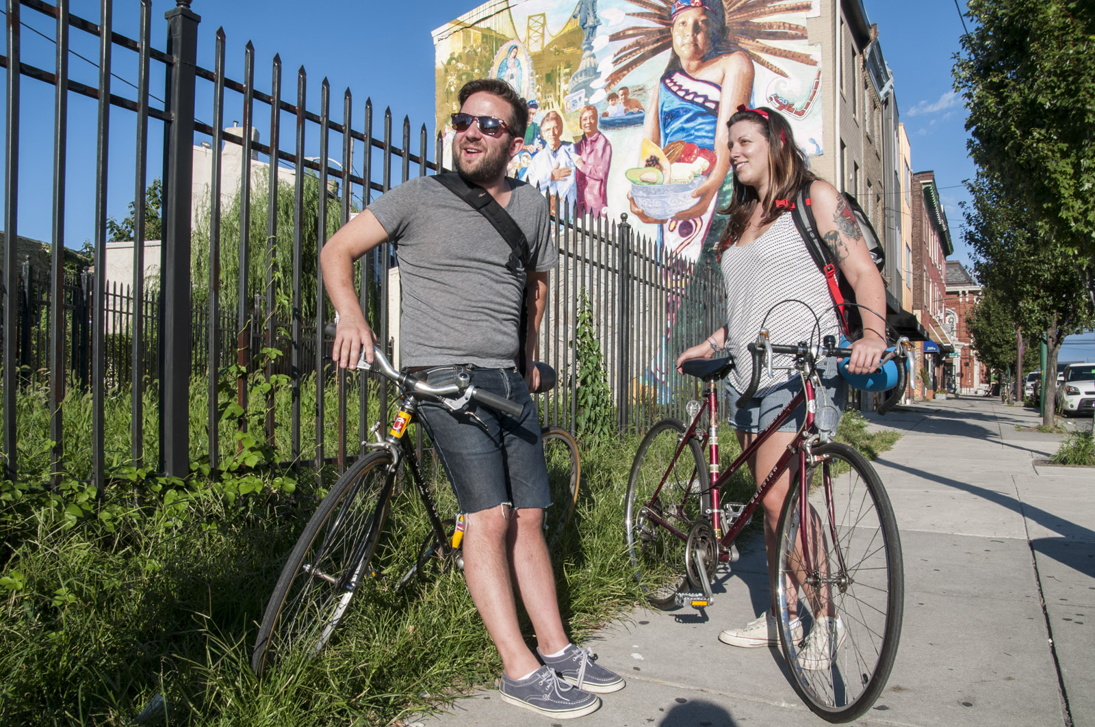
Photograph by Ellie Seif
1200 Block
Young couple who recently moved into Old Kensington and said, “We love living here.”

Slide 35
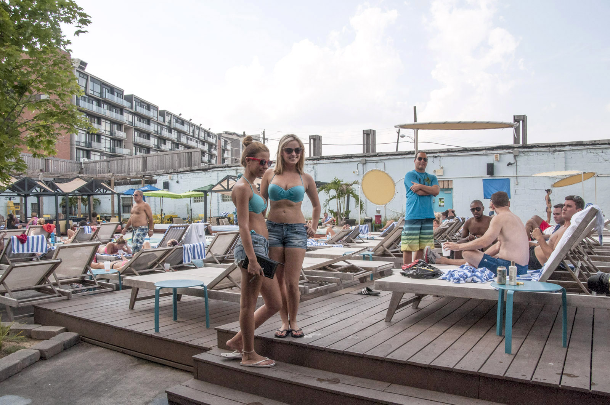
Photograph by Ellie Seif
1000 Block
North Shore Beach Club hidden behind a brick wall in Northern Liberties.

Slide 36
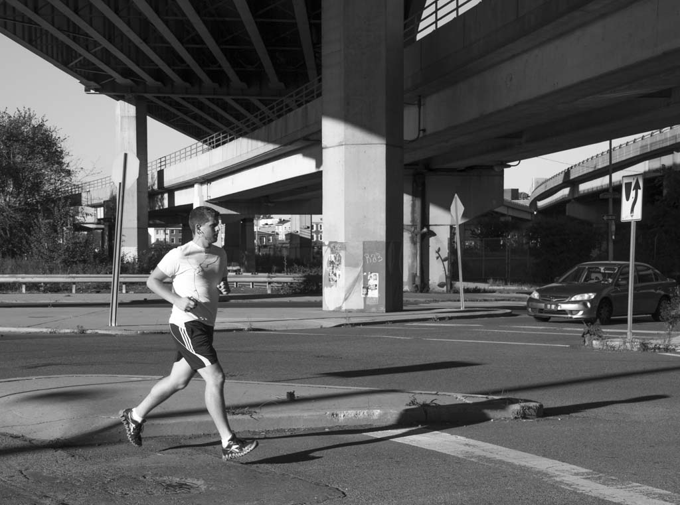
Photograph by Carolyn Johnson
1000 Block
Underneath I-95 where Germantown Ave. ends… or begins.

